Slide 1
DHANALASKSMI SRINIVASAN ENGINEERING COLLAGE PERAMBALUR FOREST FIRE DETECTION USING ARTIFICIAL INTELLIGENCE .

Slide 2


IBM –PROJECT-14165-1659543539 TEAM ID:PNT2022TMID8316 TEAM MEMBERS CAROLIN PAVITHRA.C(810419104019) JANNATHBE.A (810419104036) KIRUTHIKA.M (810419104049) KOKULA LAKSHMI.G (810419104051)
A

Slide 3
Introduction
In the past, fire prevention devices were not available. Selected members of the community were assigned to monitor the area (especially at night) for fires. If they happen to detect a fire, they would alert people by ringing a church bell or by blowing a unique whistle. Upon hearing the bell or the sound of the whistle, the members of the community would work together to put out the flame..

Slide 4
*As time went on, communities grew larger and larger, this system was slowly abolished. In the 1850s a special wooden rattle was invented in Australia that was shaken to alert or to wake people from sleep in the event of a fire.
*In 1852, William F. Channing and Moses Farmer developed two fire alarm boxes that contained a telegraphic key. When a fire was detected, someone will quickly crank the handle of the fire alarm box. When this is done, the telegraph in the box instantly sends the fire alarm box number to a general alarm station. As soon as the telegraphers at the central station receive the message, they would notify a fire response team to go to the location of the box.
*The first modern high-tech fire alarmsOpens in a new tab. were developed in the 21st century. These alarms use modern technologies like a private radio system, a cellular transmitter, and a digital communicator system. Morden fire alarms can transmit signals to the nearest fire department in a few seconds, after which a fire team will be dispatched.
*In the 1930s, the first smoke detector was accidentally invented by a Swiss physicist Walter Jaeger. He was initially attempting to build a sensor that could detect poisonous gas. However, when, he lit a cigarette his invention detected the smoke particles that exuded from it.
*Smoke detectors were super expensive back in the day, so they were not used commercially. But things changed for the better in 1966, when Duane D. Pearsall and Stanley Bennett Peterson invented the first home smoke detector, which was affordable. Despite the fact that it was cheap, it wasn’t widely used in homes in the US until the early 1990s.

Slide 5
*1980s, legislation that required smoke detectors to be installed in every home was passed in the United States. Despite the legislation, people slowly took action. A research that was conducted in 1933 showed that only 92 per cent of homes in the US had smoke detectors. As time when by, more and more people came to see the importance of the device. Today almost every home in the US has a smoke detector device.
Equipment and tools for detecting fires
Fire detection equipment is a critical part of a building’s safety. When they are working properly, they can alert the residents of a building of a fire before it spreads or gets out of control, giving them enough time to escape to safety as explained in the evacuation plan hereOpens in a new tab.. Smoke and fire detecting equipment comes in different forms; flame detectors, Co2 gas detectors, heat detectors, smoke detector,s and so on.
Heat detectors:
These devices are usually installed in areas with fixed temperatures like- kitchen facilities and small rooms. They should never be installed in areas with fluctuating temperatures. And this is because the alarm embedded in heat detectors are programmed to go offOpens in a new tab. if there is a sudden change in temperature.
Fire detectors:
These are devices that are programmed to detect flames. When working properly, they accurately detect the ignition point of a fireOpens in a new tab.. They are used in residential and industrial structures.

Slide 6
UV flame detector:
An Ultra Violet flame detectorOpens in a new tab. device is usually used in high-risk or fire-prone structures, where fires can spread rapidly.
Thermal detector:
There are two main types of thermal detectors- thermo-velocimetric detectors and fixed temperature detectors.
Thermo-velocimetric detector- They are programmed to ring out when there is a rapid change in ambient temperature.
smoke detector
Smoke detectors are designed to detect fires almost instantly. They are somewhat different from flame detectors.
types of smoke detectors
1.Ionization alarms
2.Photoelectric alarms
3.Combination alarms

Slide 7
Ionization alarms – A small quantity of radioactive material is embedded in these alarms. There are two well-spaced electrodes in the chamber. The radiation allows a small charge to flow between the electrodes in the chamber. If smoke enters the compartment, it quickly absorbs the alpha particles. This, in turn, results in an interruption in the flow of current. When this happens, the alarms will go off.
Photoelectric alarms – They operate with the use of photoelectric sensory, a light source, and a beam collimating system. When smoke enters the optical chamber, it obstructs the path of the light beam. This results in the light rays being scattered by the smoke. The scattered light is then beamed to the sensor, which in turns activated the alarm.
Combination alarms – These are special smoke detectors that have the features of the photoelectric and ionization alarm technologies. The ionization function responds to intense, high energy flames. The photoelectric function responds to smouldering or low energy flames.
Why smoke detectors are important
Residential fires claim the lives of some 2000 people each year in the United States alone. In a fire, deadly gases and smoke spread a lot faster than heat. Most fire victims don’t die from burns but from continuous inhalation of toxic gasses and smoke. A smoke detector stand guards day and night, and when it senses traces of smoke, it sounds an alarm. This allows families the precious time to escape.
Most fatal fires occur at night when families and occupants are fast asleepOpens in a new tab., unaware of the danger that is lurking until it is too late.

Slide 8
ARCHITECTURE DIAGRAM FOR FOREST FIRE DETECTION

Slide 9
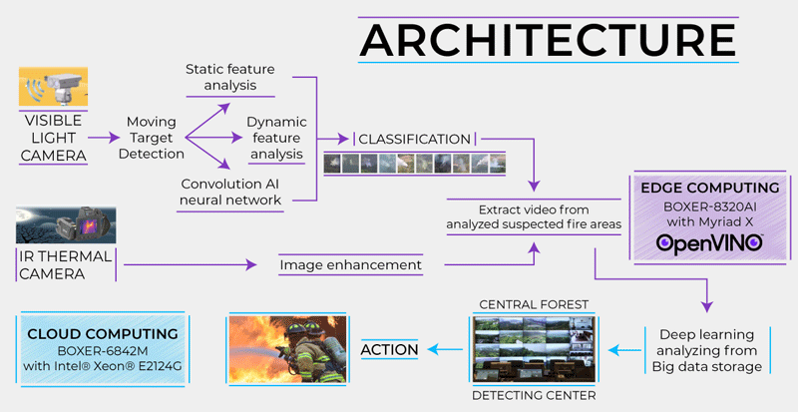

Slide 10
IMPORTANCE OF FORSEST FIRE DETECTION

Slide 11
*The first detectors were for the detection of heat, and as time and technology advanced, they were also used for fixed temperature, rate-of-rise, rate anticipation and linear. These detectors are still in use today and for a number of applications remain a viable means of detection, though not for the purpose of life safety.
*Through the use of thermistors and the software/firmware of the detector and the system, I do see that the Response Time Index (RTI) of a heat detector can be reduced so that the detection of a thermal event could be more quickly detected.
*Fire alarm systems, however, are designed and installed in the majority of applications for life safety. The only detector that is used for this application is the smoke detector. Smoke detectors and smoke alarms are and remain as the single best method for the early detection of a fire and have saved countless lives. These devices however have one principle problem, they are a source for unwanted alarms.
*Since the first generation of smoke detectors were released, there have been a number of advancements to both decrease the time of detection while at the same time decrease the activation of the detector when the products of combustion are not present. Smoke detectors and alarms are migrating from just the detection of smoke, to combination detectors and multicriteria detectors.

Slide 12
*The future will be with multicriteria detection in which the detector will be more of a sensor, with the detection more for the products of combustion, such as carbon monoxide, carbon dioxide, sulfur dioxide, nitrogen oxides in addition to heat and particulate matter
*Sensors will also have the ability to sense or track when a room is occupied or not and have the ability to be integrated with occupant notification and evacuation. The development of more advanced algorithms and artificial intelligence, both within the sensor itself and the front end control unit will decrease the time from the beginning of an event to the notification of the event.
*It is not improbable that detection technology will be able to detect an incipient fire at that stage rather than at the flaming stage. This at the same time could reduce the likelihood of an unwanted activation from occurring.
*Within the next decade, video image detection (VID) will become more mainstream in which, through analytics, the image of either smoke or flame will be able to be isolated and detected from within a room or space. The VID system would also be able to detect if an individual is within the space and through the integration with the notification appliances, provide a path of exit.
*In regard to the notification to the occupants, within the United States we are still primarily sounding an alarm throughout the occupancy and trusting that the occupants will heed the warning and head to the nearest exit.

Slide 13
*Through the reduction of unwanted alarms, the human behavior regarding alarms does need to change so that when an alarm does occur, occupants are not waiting for a second indication that there is a fire, such as smoke, and will instead depart the premises without additional indicators
*If the individual is familiar with the building, they generally know the location of exits. However, if one is not familiar with the occupancy or if there may be a blockage of one of the exits, then the notification system should be able to aid the occupants with a direct and safe exit.
*I see this as the future with notification within a premise, in which the fire detection system will, through sensors, know where the occupants are in relation to where the alarm is being generated from and be able to guide them away from the event to an exit. This may be through messaging via notification appliances but could also be through the interface of the detection and notification system to the smart device that the building occupants would have on them.
*Occupant location is also vital information for first responders. At the present time, if there is an active fire within a structure, the first duty is to perform a primary search and then a secondary search of the building to make certain that no one is still inside.
*This does take time away from suppression and does increase the risks to the first responders that are conducting the searches. Through the use of sensors and VID, the location of an individual or individuals could be detected by the system and relayed to the first responders so that they could go directly to where they are located.

Slide 14
BENEFITS AND ADVANTAGES

Slide 15
BENEFITS
Early Fire detection that notifies agencies with exact GPS location before fire spreads
Estimates the risk of fire before the fire starts with the help of built-in sensors and embedded AI layer
Collects environmental data and shares freely with non-profits, universities, and independent scientists for climate change and global warming research
ADVANTAGES
Continuous monitoring of forest fires: all year round, on the whole or part of the territory, day and night.
Time saving: real-time visualization of the disaster, immediate transmission of alarms, precise localization of the source of the fire thanks to a triangulation system. ...
Elimination of human risks: no more isolated men on watch towers.

Slide 16
CONCLUSION

Slide 17
Detecting fires with artificial intelligence A large proportion of the forests destroyed each year could be saved with the Dryad forest fire detection system. Small but intelligent, its inbuilt Bosch BME688 sensor detects carbon monoxide, hydrogen, and other gases emitted in the early stages of a forest fire.

Slide 18
THANK YOU

